Slide 1
Unit-IV-BackTracking

Slide 2
What is Backtracking?
Ex: Rubik’s Cube

Slide 3
Problem Categories
Finding whether there is any feasible solution--- Decision Problem
What is the best solution--- Optimization Problem
Listing all feasible solutions--- Enumeration Problem

Slide 4
General Method
The desired solution must be expressible as n-tuple (x₁,x₂,...,x_{n}) where x_{i} ∈S_{i}; S_{i} is a finite set.
Often the problem to be solved calls for finding (x₁, x₂,...,x_{n}) which satisfies (maximizes or minimizes) criterion function P(x₁,x₂,...,x_{n}).

Slide 5
Basic Idea
Buildup the vector, one component (x₁, x₂,...,x_{n}) at a time and use modified criterion functions P_{i}(x₁, x₂,...,x_{n}) (also called bounding functions) to test whether the vector formed has any chance of success?
Advantage- We can realize the fact that partial solution generated does not lead to an optimal solution then the vector can be ignored.

Slide 6
Two types of constraints
1) Explicit Constraint
Are the rules which restrict each x_{i} to take value from a given set.
Ex. x_{i} = 0 or 1 or S_{i} = {0, 1}
l_{i} ≤ x_{i} ≤ u_{i} or S_{i} = {α : l_{i} ≤ α ≤ u_{i}}
All tuples that satisfy explicit constraints define a possible solution space.
2) Implicit Constraint
determine which of the tuples in the solution space actually satisfy the criterion function.
“they describe the way in which the x_{i} must be related to each other.”

Slide 7
8-Queen’s Problem
Place 8 queens on the 8×8 chess board so that no two queens attack each other, i.e. no two of them are on the same row, column, or diagonal.
Number rows and columns of chessboard 1,2,...,8. Since each of them must be on different row, we assume that queen i is places on row i.
All solutions to 8-queens problem can now be represented as 8-tuples (x₁, x₂,...,x₈) where x_{i} is the column on which queen i is placed.

Slide 8
The explicit constraints using this formulation are:
S_{i} = {1,2,...,8}, 1≤ i ≤ n
The solution space consist of 8⁸ tuples.
The implicit constraints for this problem are:
1. No two x_{i}’s can be same (i.e., all queens must be placed on different columns).
2. No two queens can be on the same diagonal.

Slide 9
The first of these constraints implies that all solutions are permutations of 8-tuple (1, 2, 3, 4, 5, 6, 7, 8).
This realization reduces the size of the problem space to 8! tuples.

Slide 10
8-queen’s problem
1 2 3 4 5 6 7 8
1
2
3
4
5
6
7
8

Slide 11
8-queen’s problem
1 2 3 4 5 6 7 8
1
2
3
4
5
6
7
8

Slide 12
8-queen’s problem
1
x₁ = 1
x₁ = 2
x₁ = 3
x₁ = 4
2
18
34
50
3
8
13
19
24
29
35
40
45
51
56
61
4
6
9
11
14
16
20
22
25
27
30
32
36
38
41
43
46
48
52
54
57
59
62
64
5
7
10
12
15
17
21
23
26
28
31
33
37
39
42
44
47
49
53
55
58
60
63
65
Tree organization of 4-queens solution space

Slide 13
Backtracking algorithms determines problem solutions by systematically searching for the solution space for the given problem instance.
Solution space- All paths from the root to leaf node
This search is often facilitated by a tree organization (permutation tree) for the solution space.

Slide 14
Terminology regarding tree organization of solution space-
Problem State: Each node in a tree defines a problem state.
State space: All paths from the root to other nodes define the state space of the problem.
Solution states: Solution states are those problem states S for which the path from the root to S defines a tuple in the solution space.

Slide 15
Answer states: Answer states are those problem states S for which the path from the root to S defines a tuple which is the member of the set of solutions (i.e. satisfies implicit constraints).
State space tree: Tree organization of the solution space is state space tree.
Once the state space tree has been conceived for any problem, this problem may be solved systematically generating the problem states, determining which of these are solution states and finally determining which solution states are answer states.

Slide 16
Promising Node
Non Promising node

Slide 17
There are two different ways of generating the problem states, both begin with the root node and generate other nodes.
Live node: A node which has been generated and all of whose children have not yet been generated is called a live node.
Dead node: A dead node is a generated node that is not to be expanded further, or one, for which all its children have been generated.

Slide 18
E-node: The live node whose children are currently being expanded is called the E-node.
In both the method of generating the problem states, we will have a list of live nodes.
Bounding function- used to kill live nodes without generating all their children
Depth first node generation wilth bounding function is called backtracking.

Slide 19
Chapter 7: Backtracking
4-queen’s problem
1
1
*
*
2

Slide 20
Chapter 7: Backtracking
4-queen’s problem
1
1
2
2
*
*
*
*
*
3

Slide 21
Chapter 7: Backtracking
4-queen’s problem
1
1
2
3

Slide 22
Chapter 7: Backtracking
4-queen’s problem
1
1
*
*
*
2
2
3
4

Slide 23
4-queen’s problem
Start with the root node as only live node, this becomes the E-node and the path is ()

Slide 24
Chapter 7: Backtracking
1
x
1
= 1 x
= 2
1
1
2
18
2
18
x
=2
x
=3
x
=4
x
=1 x
=3
x
=4
2
2
2
1
2
2
3
8
13
19
24
29
3
8
13
19
24
29
B
B B
x
=2
x
=4
x
=2 x
=3 x
=1
3
3
3
3
3
9
11
14
16
30
9
11
14
16
30
B B B
x
=3
x
=3
4
4
15
31
15
31
B

Slide 25
General Backtracking Algorithm
Assume that all answer nodes to be found
Let (x₁, x₂,…x_{i}) be the path from root to a node
Let T(x₁, x₂,…x_{i} ) be the set of all possible values fro xi+1such that (x₁, x₂,…x_{i ,} x_{i+1}) is also a path to a problem state
T(x₁, x₂,…x_{n}) = 0
If B_{i+1}(x₁, x₂,…x_{i+1}) is false then path can not be extended to reach to answer node
Candidates for position i+1 should be generated by T and satisfy B_{i+1}

Slide 26
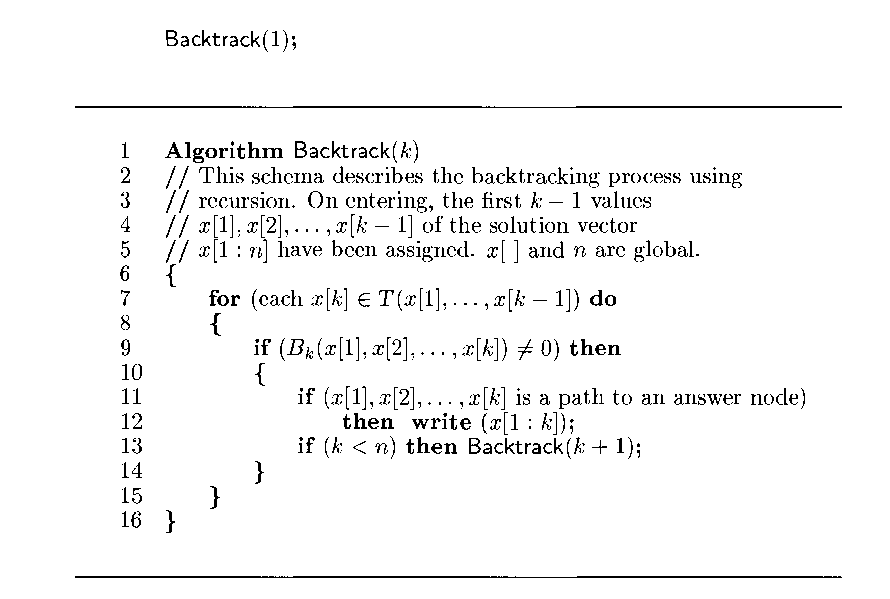
General recursive Backtracking

Slide 27
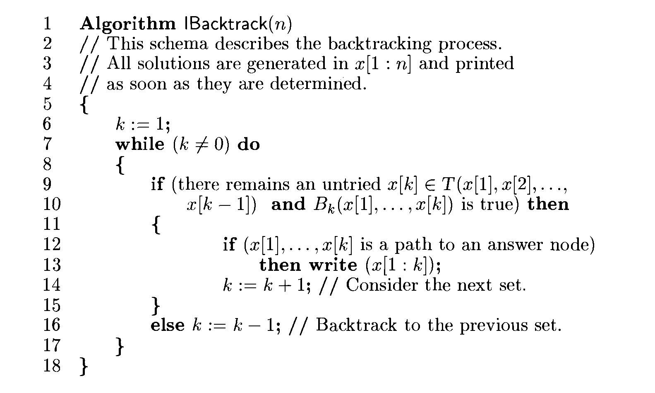
General Iterative Backtracking

Slide 28
N-Queen’s problem
Suppose that two queens are placed at (i, j) and (k, l) positions.
They are on the same diagonal iff
i - j = k – l or j – l = i – k j – l = k – i
Two queens lie on the same diagonal iff
| j - l | = | i - k |

Slide 29
N-Queen’s problem
If we imagine the squares of the chess board being numbered as indices of two dimensional array A[1..n, 1..n], then for every element on same diagonal running from upper left to lower right, each element has same “row-column” value.
Similarly every element on the same diagonal running from upper right to lower left has the same “row+column” value.

Slide 30
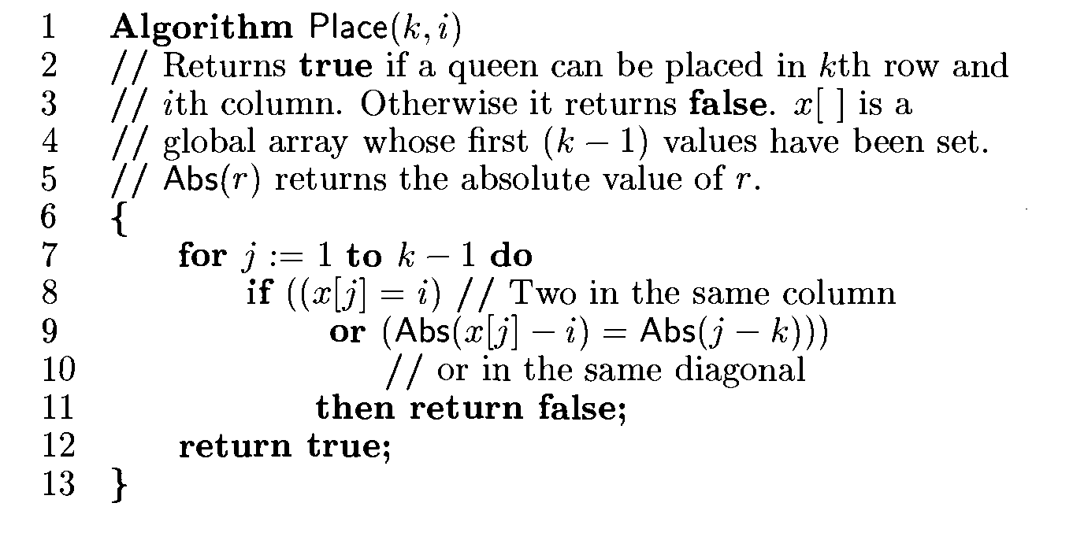
N-Queen’s problem

Slide 31
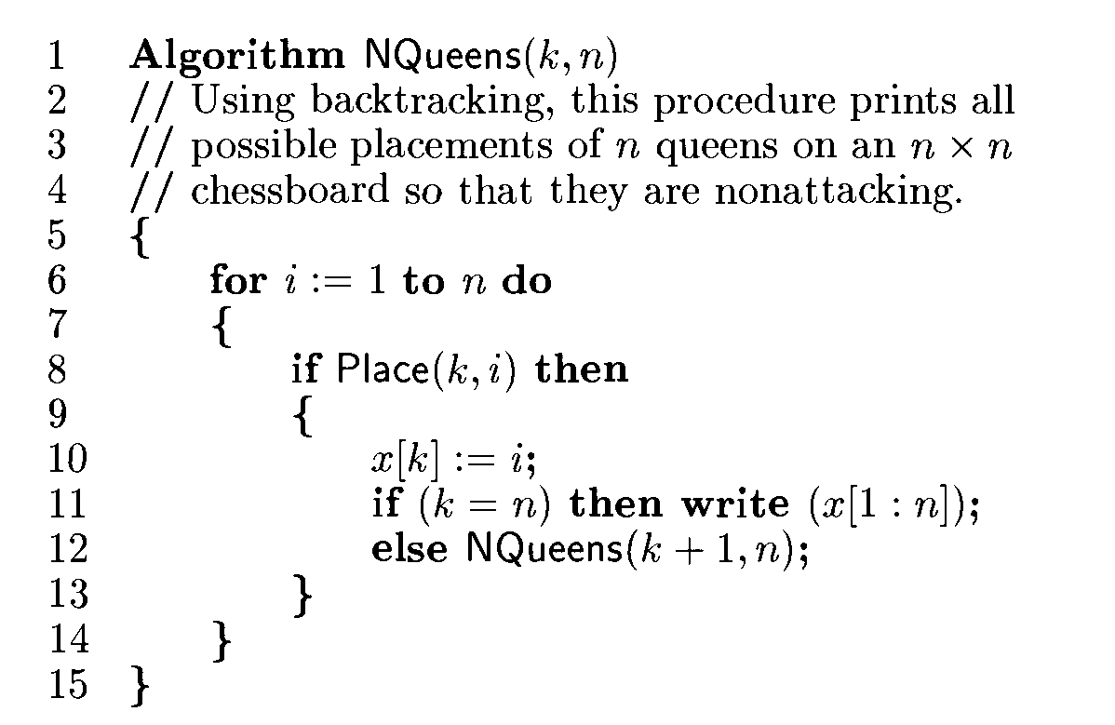
N-Queen’s problem

Slide 32
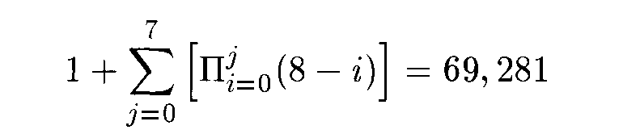
N-Queen’s problem
The total number of nodes in the 8-queens state space tree is
The estimated number of unbounded nodes is only about 2.34% of the total number of nodes in the 8-queens state space tree.

Slide 33
Algorithm Estimate( )
//This algorithm follows a random path in a state space tree and produces an
estimate of the number of nodes in the tree.
{
k := 1; m := 1; r :=1;
repeat
{
Tk := {x[k] | x[k] ε T( x[1], x[2], ..., x[k-1])
and Bk(x[1],..., x[k]) is true};
if (Size(Tk) = 0) then return m;
r := r * Size(Tk); m:= m + r;
x[k] := Choose(Tk); k:= k + 1;
} until (false);
}

Slide 34
SUM OF SUBSETS
Suppose we are given n distinct positive number and desire to find all combinations of these number whose sums are m

Slide 35
Sum of subsets
Given positive numbers Wi, 1 < i < n, and m, this problem calls for finding all subsets of the wi whose sums are m.
For example, if n = 4, (w1, w2, w3, w4) = (11, 13, 24, 7), and m = 31, then the desired subsets are (11, 13, 7) and (24, 7).

Slide 36
Formulation
1.Variable tuple size
2.Fixed tuple size

Slide 37
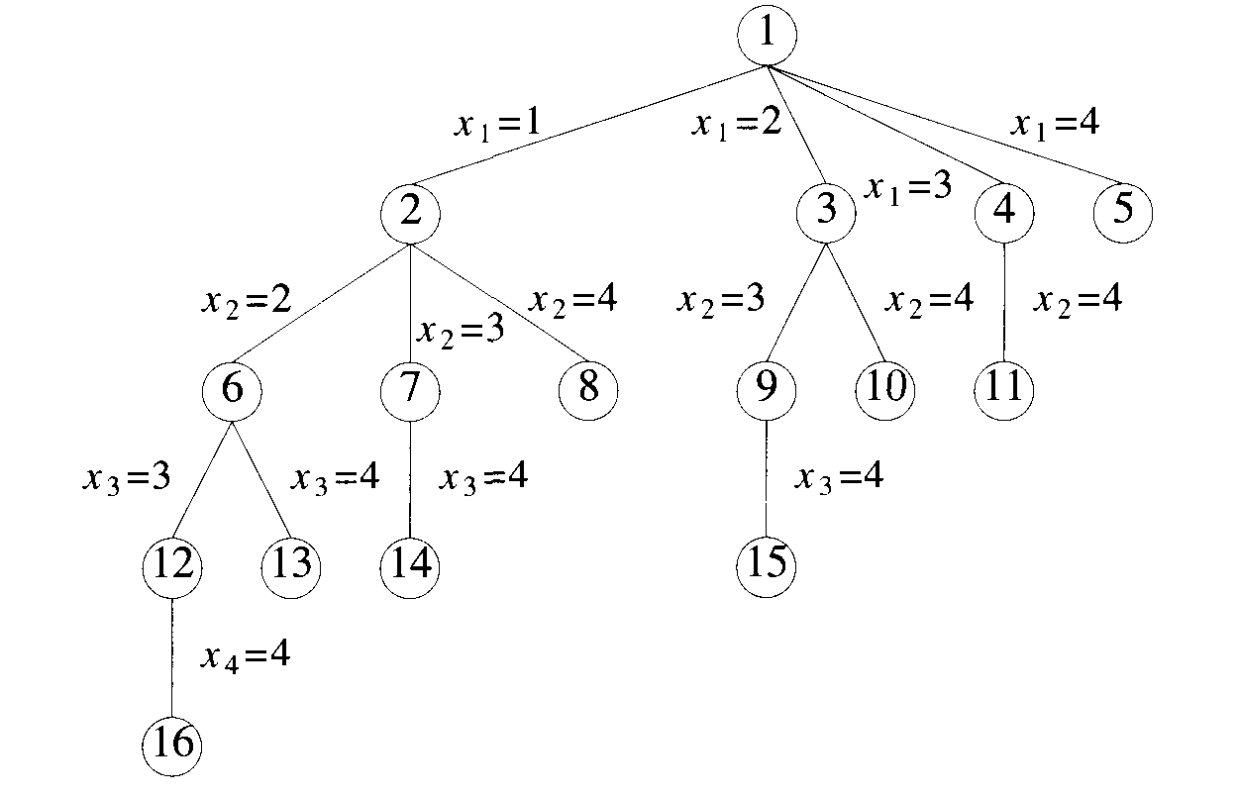
Sum of subsets

Slide 38
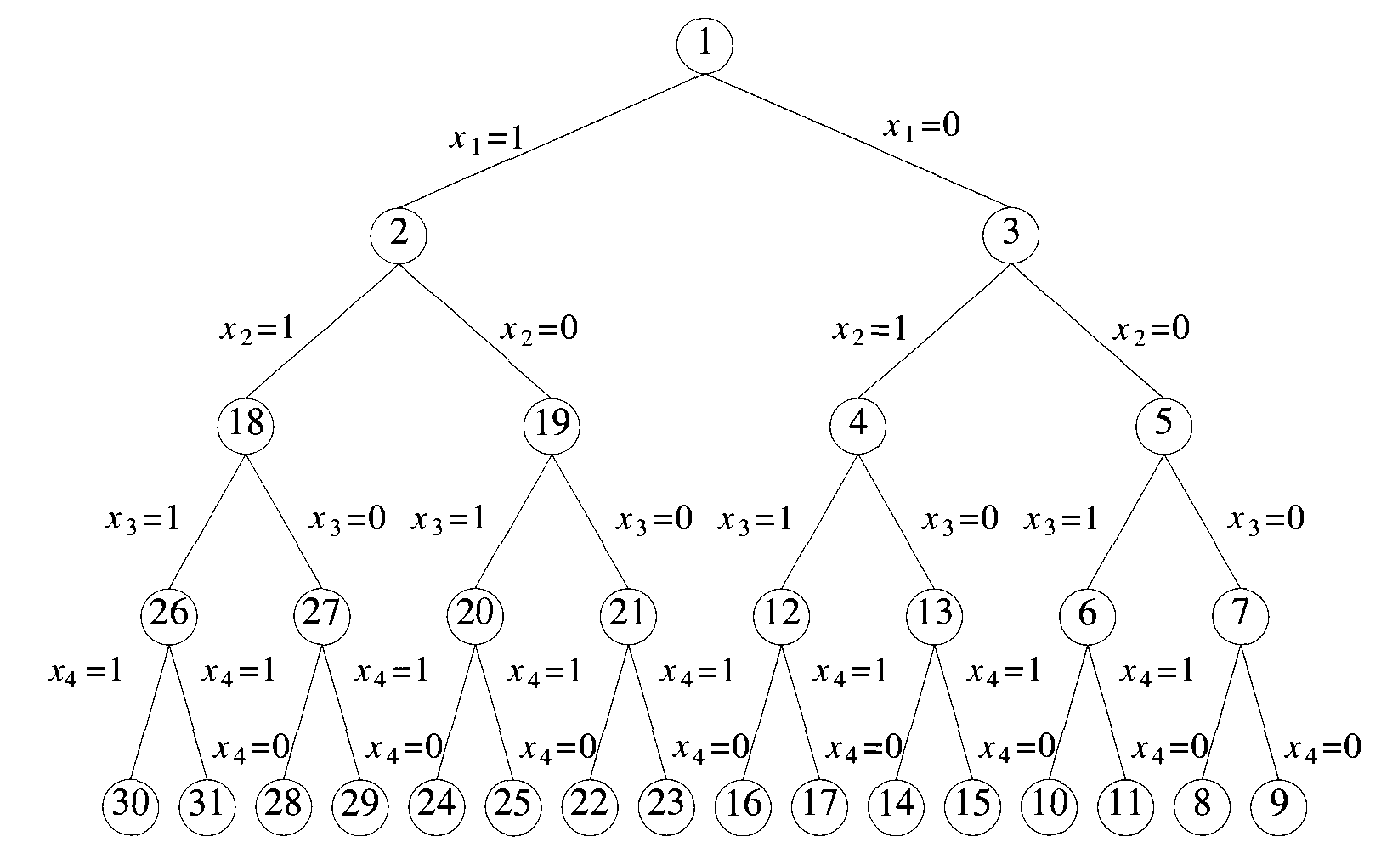
Sum of subsets

Slide 39
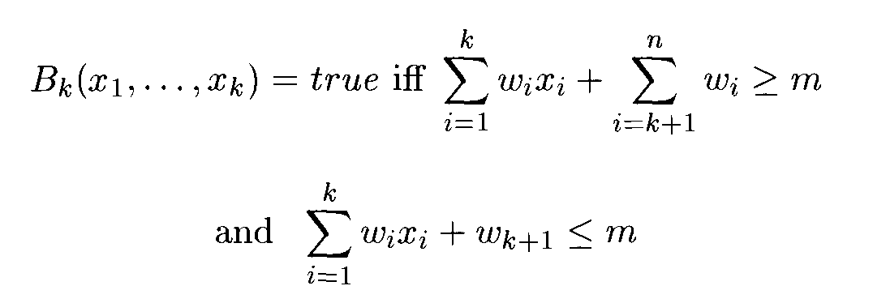
Sum of subsets
Assume fixed tuple size strategy
Algorithm SumOfSub avoids computing and each time by keeping these values in variables s and r respectively.
The algorithm assumes w₁<= m and
The initial call is SumOfSub(0,1, )

Slide 40
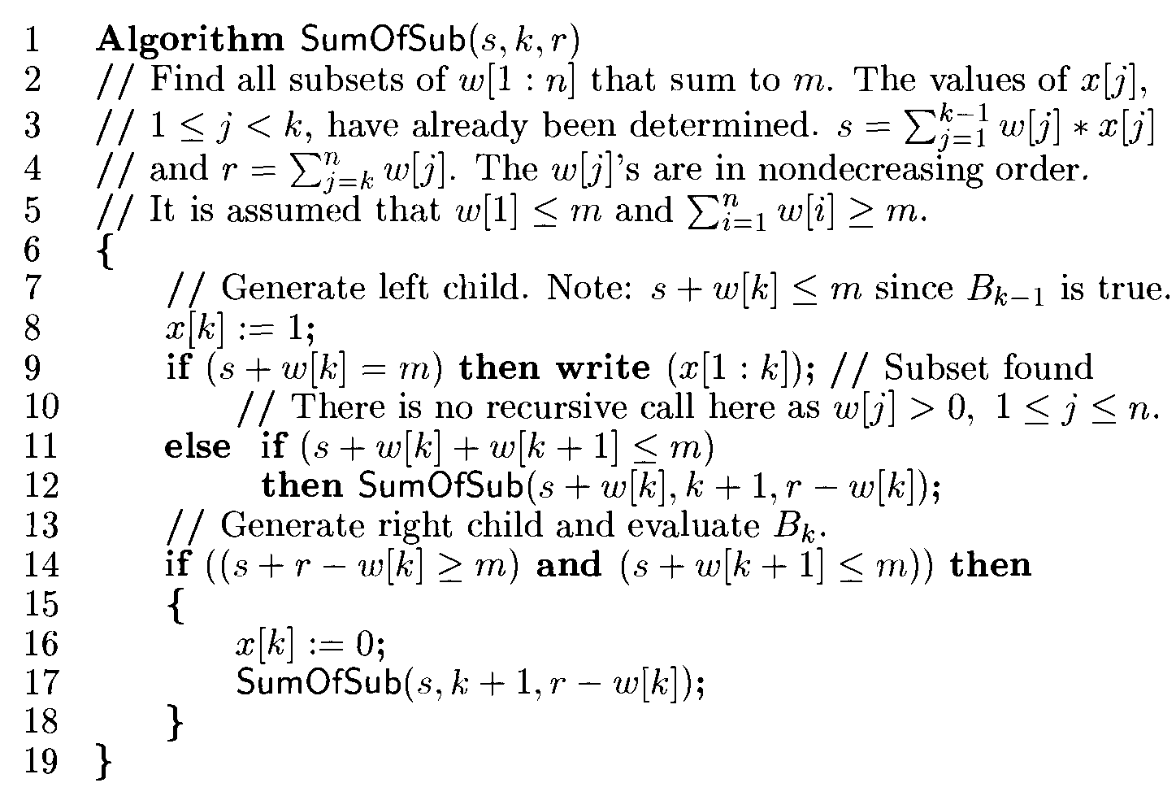
Sum of subsets

Slide 41
Example
n = 6, m = 30, and
w[1 : 6] = {5,10,12,13,15,18}.

Slide 42
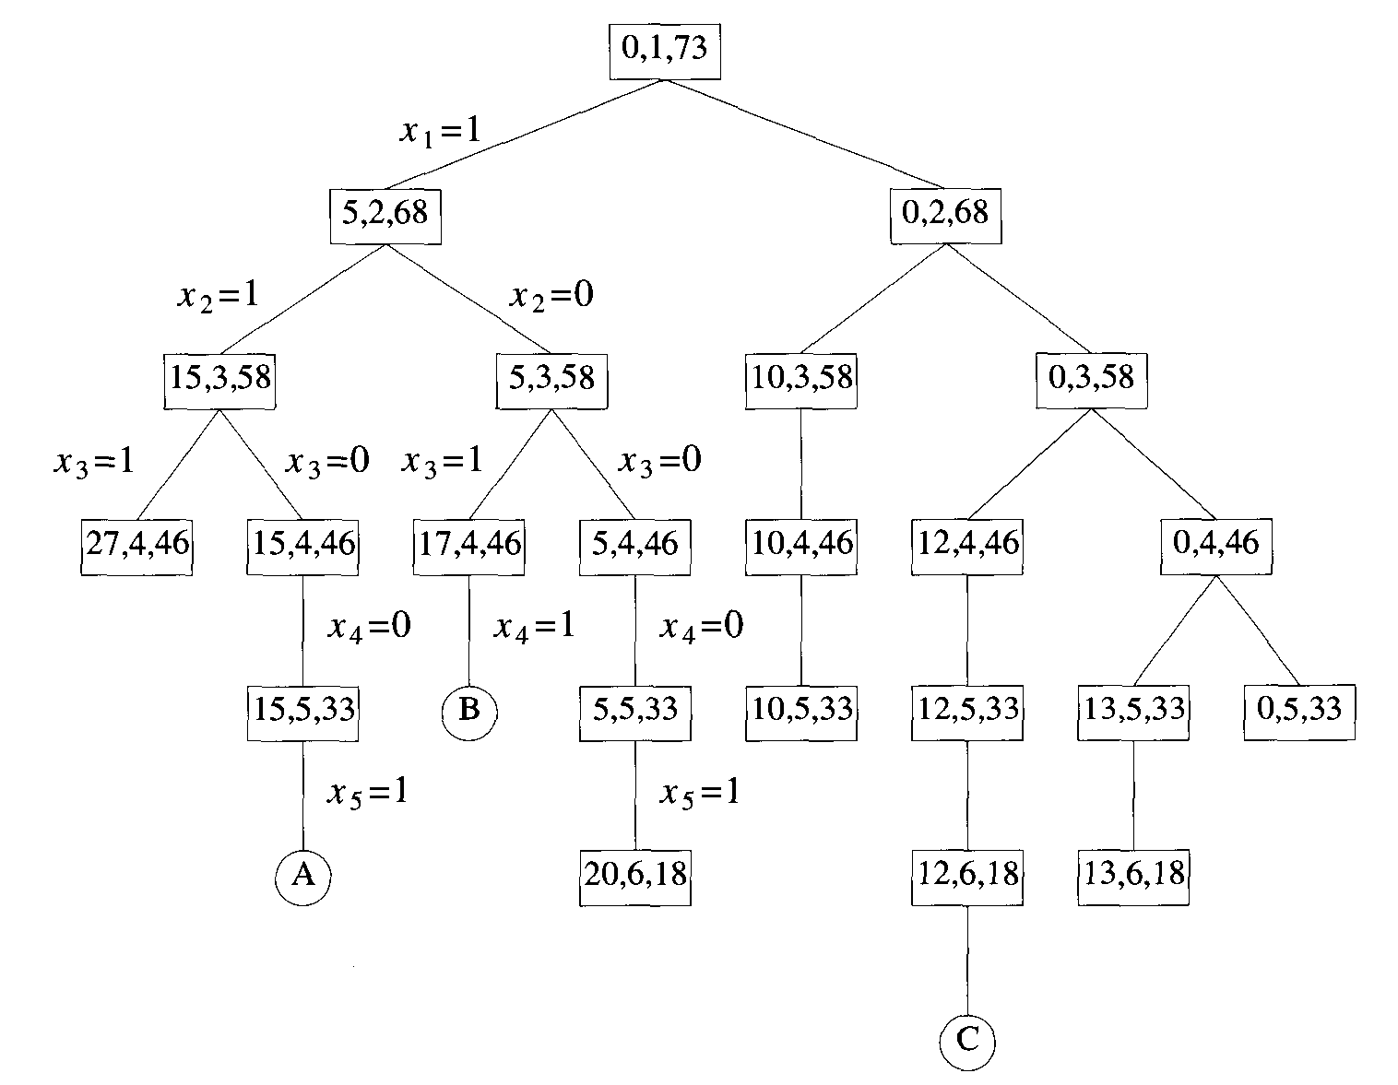
Example

Slide 43
Example
Let w = {5, 7,10,12,15,18,20} and m=35. Find all possible subsets of w that sum to m. Do this using Backtracking. Draw the portion of the state space tree that is generated.

Slide 44
Graph Coloring Problem
Let G be a graph and m be any given positive integer, we want to discover if the nodes of G can be colored in such a way that no two adjacent nodes have the same color yet only m colors are used (m-colorability decision problem).
The m-colorability optimization problem asks for the smallest integer m (chromatic number) for which graph can be colored.

Slide 45
Graph Coloring Problem
A graph is planner if it can be drawn in a plane in such a way that no two edges crosses each other.
4 color problem asks if a map can be colored in such a way that no two regions have the same color yet only four colors are needed.
Chromatic number of a Graph:is the smallest integer m that is required to color a graph G

Slide 46
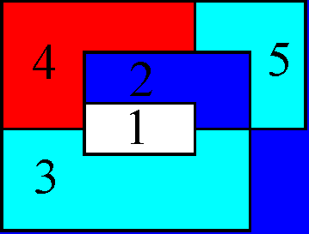
A Map and corresponding Graph
1
4
3
2
2
5
4

Slide 47
General Procedure
1.Construct planner graph from a given map
2.Identify data structure
3.Identification of explicit constraints
4.Identification of implicit constraints

Slide 48
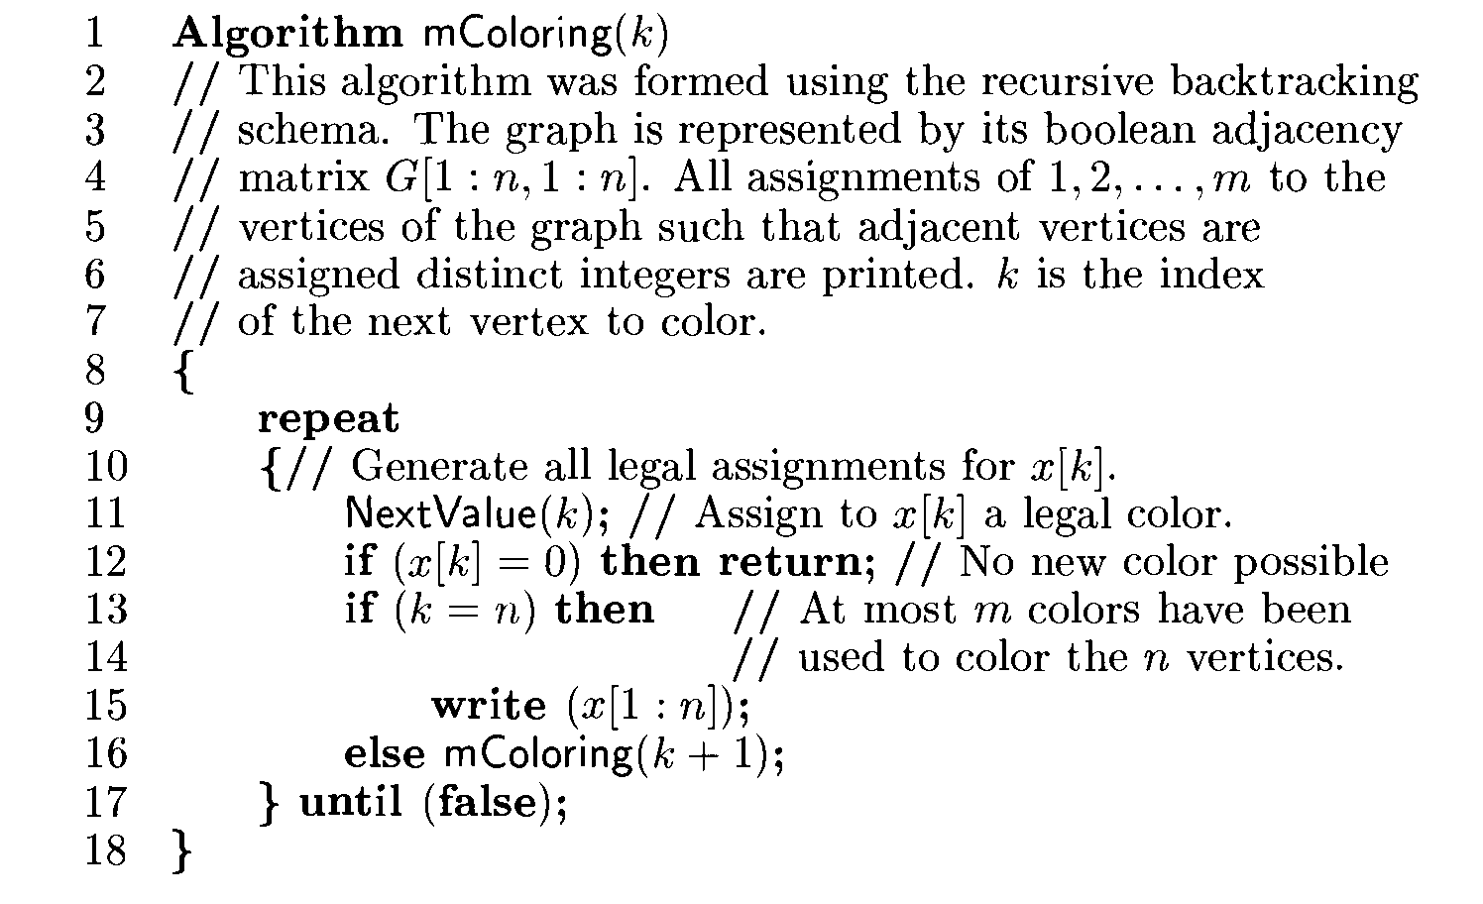
Finding all m-colorings of the graph

Slide 49
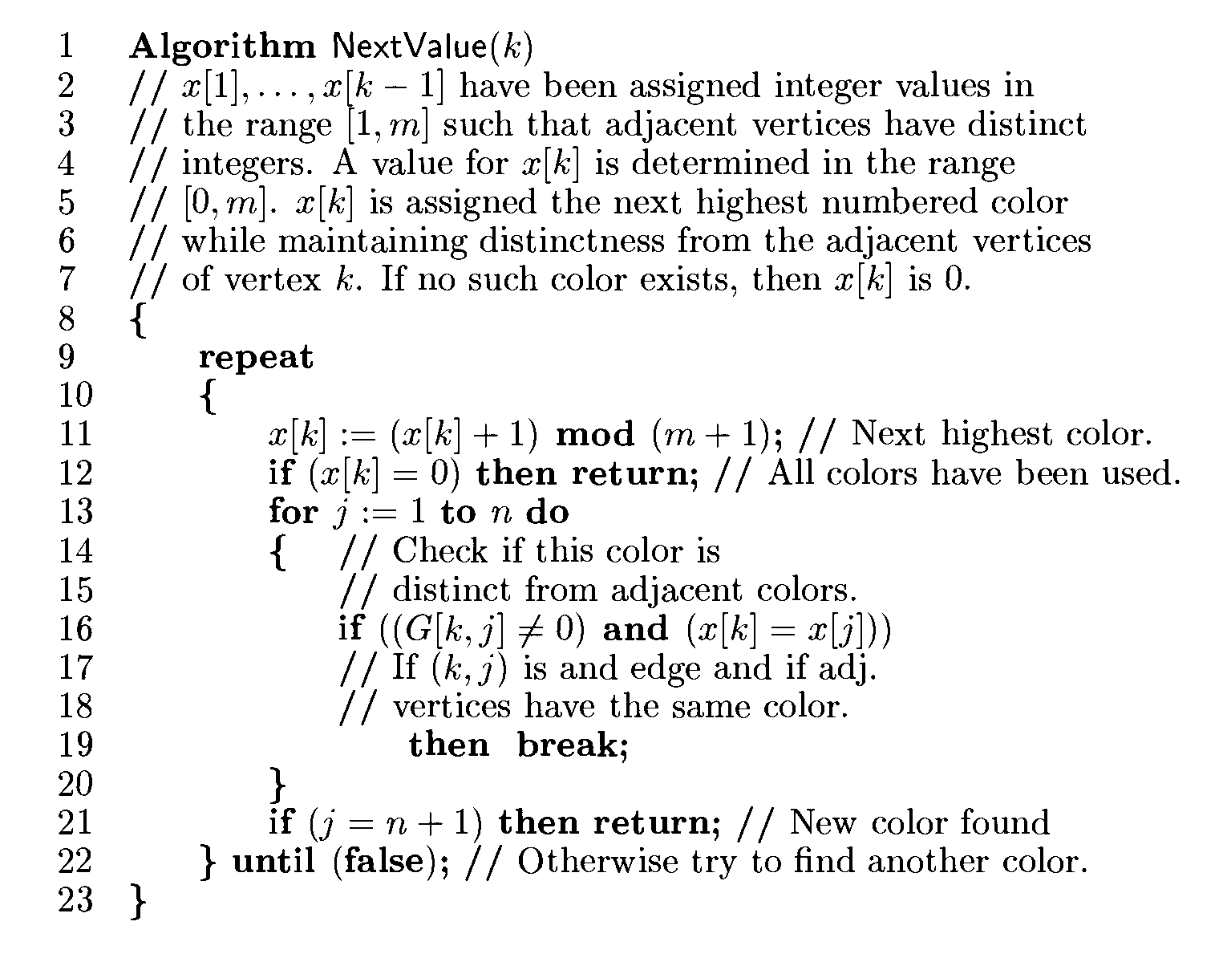
Generating next color

Slide 50
A 4-graph and possible 3-colorings
1
2
1
2
x
= 1 2 3
1
4
3
4
3
x
= 2 3 1 3 1 2
2
x
= 1 3 1 2 2 3 1 2 2 3 1 3
3
x
= 2 3 2 2 3 3 1 3 1 3 1 3 1 1 2 2 1 2
4

Slide 51
Time Complexity
No. of internal nodes in the state space tree are
where n is the number of nodes and m is the colors. At each internal node O(mn) time is needed by NextValue to determine the children corresponding to legal colorings. Hence the total time is bounded by
Exponential

Slide 52
Hamiltonian Cycles
Let G = (V, E) be a connected graph with n vertices. A Hamiltonian cycle is a round-trip path along n edges of G that visits every vertex once and returns to its starting position.
In other words if a Hamiltonian cycle begins at some vertex v₁Є G and the vertices of G are visited in the order v₁, v₂, …, v_{n+1}, then the edges (v_{i}, v_{I+1}) are in E, 1<=i<= n, and the v_{i} are distinct except for v₁ and v_{n+1}, which are equal.

Slide 53
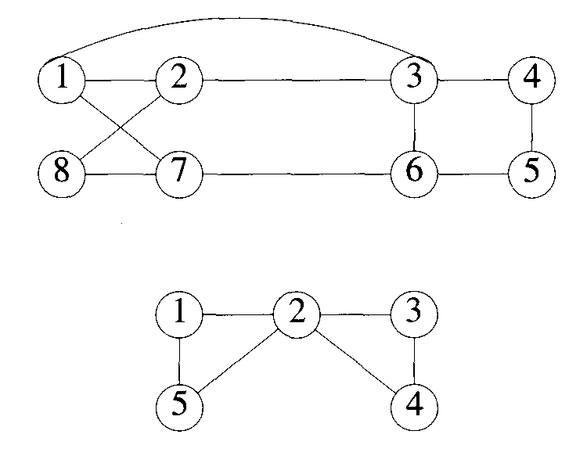
Hamiltonian Cycles
Graph G1has Hamiltonian cycle 1, 2, 8, 7, 6, 5, 4, 3, 1.
The graph G2 contains no Hamiltonian cycle.
G1
G2

Slide 54
Algorithm for Hamiltonian Cycles
A backtracking algorithm that finds all the Hamiltonian cycles in a graph. The graph may be directed or undirected.
Only distinct cycles are output.
The backtracking solution vector (x_{i},... ,x_{n}) is defined so that x_{i} represents the i^{th} visited vertex of the proposed cycle.
The vertex x_{n} can only be the one remaining vertex and it must be connected to both x_{n-1}and x₁.

Slide 55
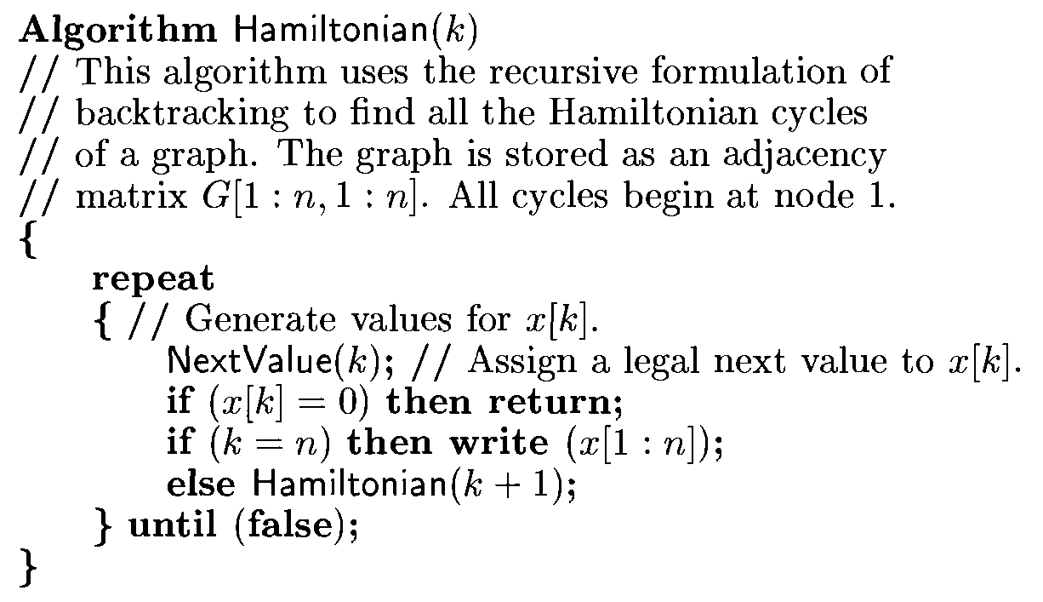
Finding all Hamiltonian Cycles

Slide 56
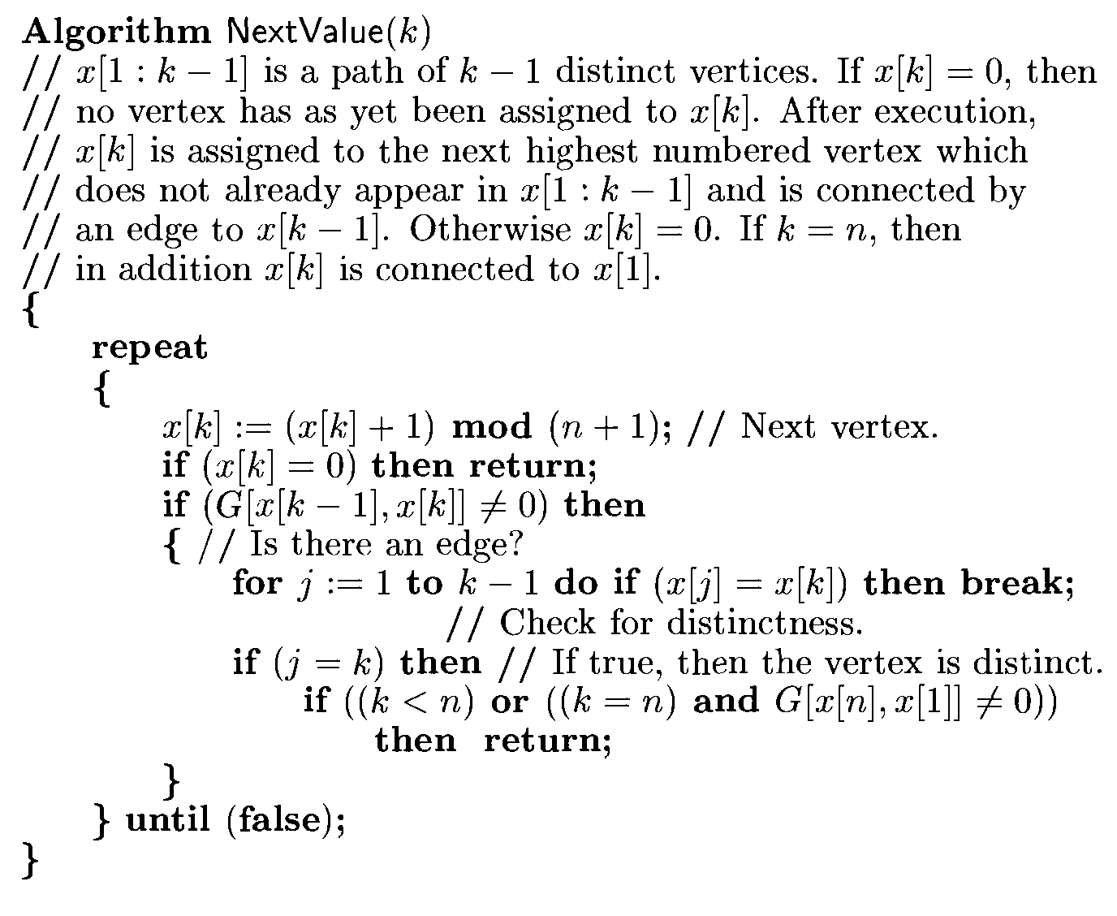
Generating a next vertex

Slide 57
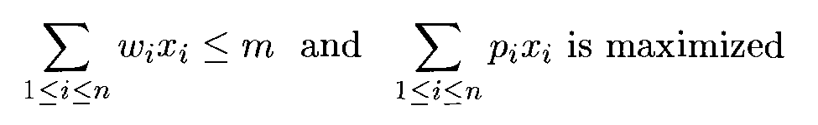
0/1 Knapsack Problem
Given n positive weights Wi, n positive profits pi, and a positive number m that is the knapsack capacity, this problem calls for choosing a subset of the weights such that
The x_{i}'s constitute a zero-one-valued vector.
Solution space– 2^{n} distinct to assign 0/1 values to x_{i}

Slide 58


0/1 Knapsack Problem
It is assumed that
A good bounding function
Using as upperbound on the value of the best feasible solution by obtaining given live node any of its descendents.
If upperbound is not higher than the value of the best solution determined so far, the live node can be killed

Slide 59
0/1 Knapsack Problem
Fixed tuple size formulation.
If at node Z the values of x_{i}, 1 <= i <= k, have already been determined, then an upper bound for Z can be obtained by relaxing the requirement x_{i} = 0 or 1 to
0<=x_{i}<=1 for k+1 <= i <= n

Slide 60
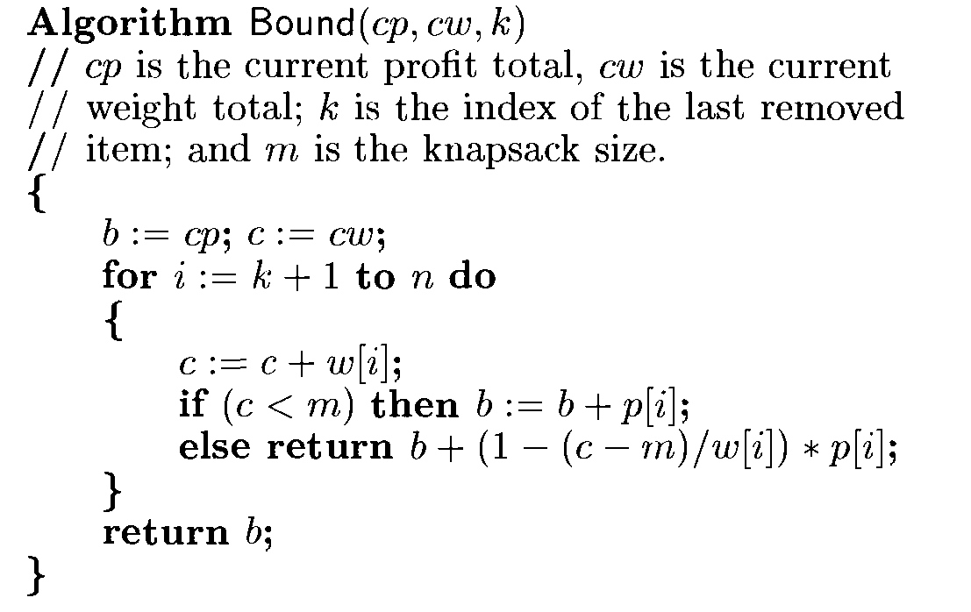
0/1 Knapsack Problem

Slide 61
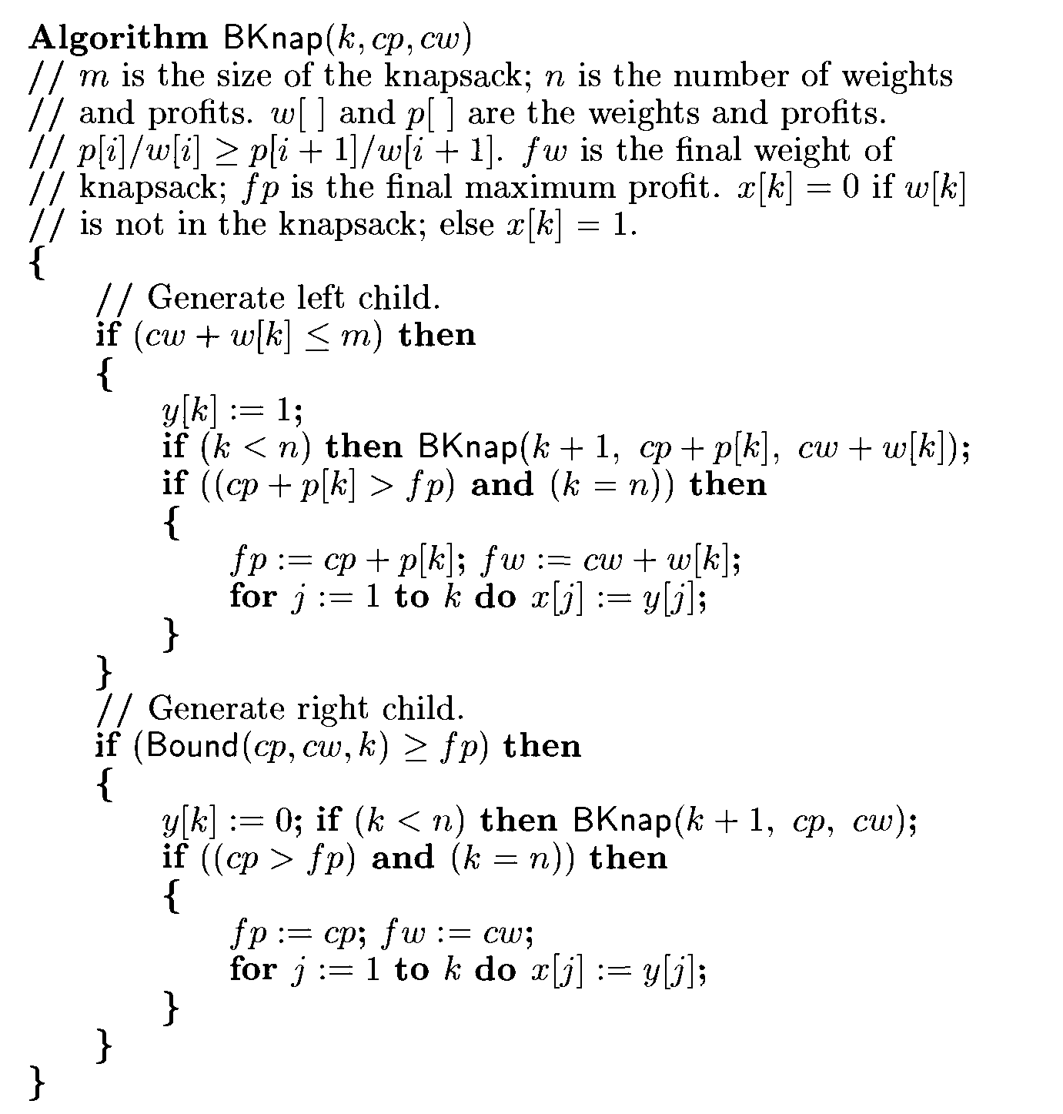
0/1 Knapsack Problem

Slide 62

0/1 Knapsack Problem
Bounding function need not be used whenever backtracking algorithm makes a move to the left child of a node.
Initially fp=-1 --- maximum final profit
Algorithm invoked as Bknap(1,0,0) when fp<>1,

Slide 63
Hamiltonian Cycles ( Non-recursive Algorithm)
void iterHam(n , G)
{
k=1
while( k )
{
if nextValue(k)
{
if x[k]==0 then return
if k==n then write ( x[1:n])
k=k+1
}else
k=k-1
}
}

Slide 64
Generating a next vertex

